Slide 1
PART 1
DETERMINISTIC ERA NETFLIX ALGO

Slide 2
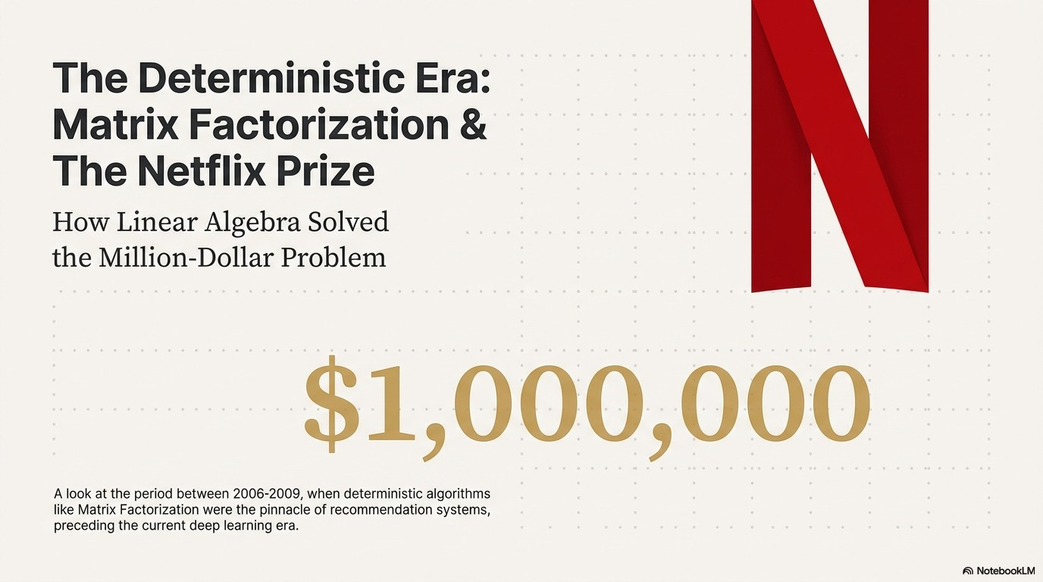

Slide 3
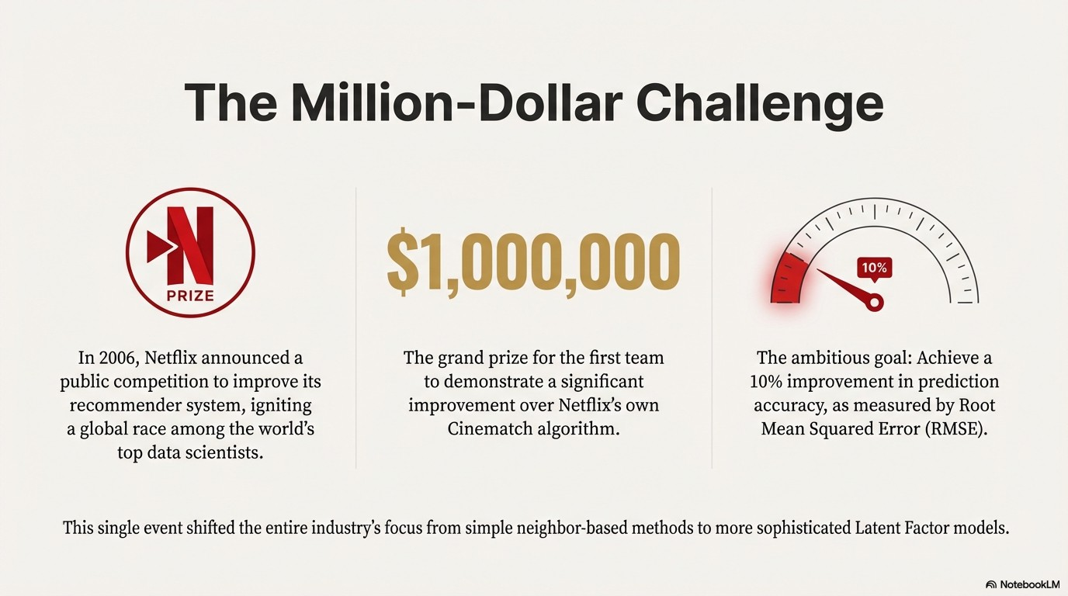

Slide 4
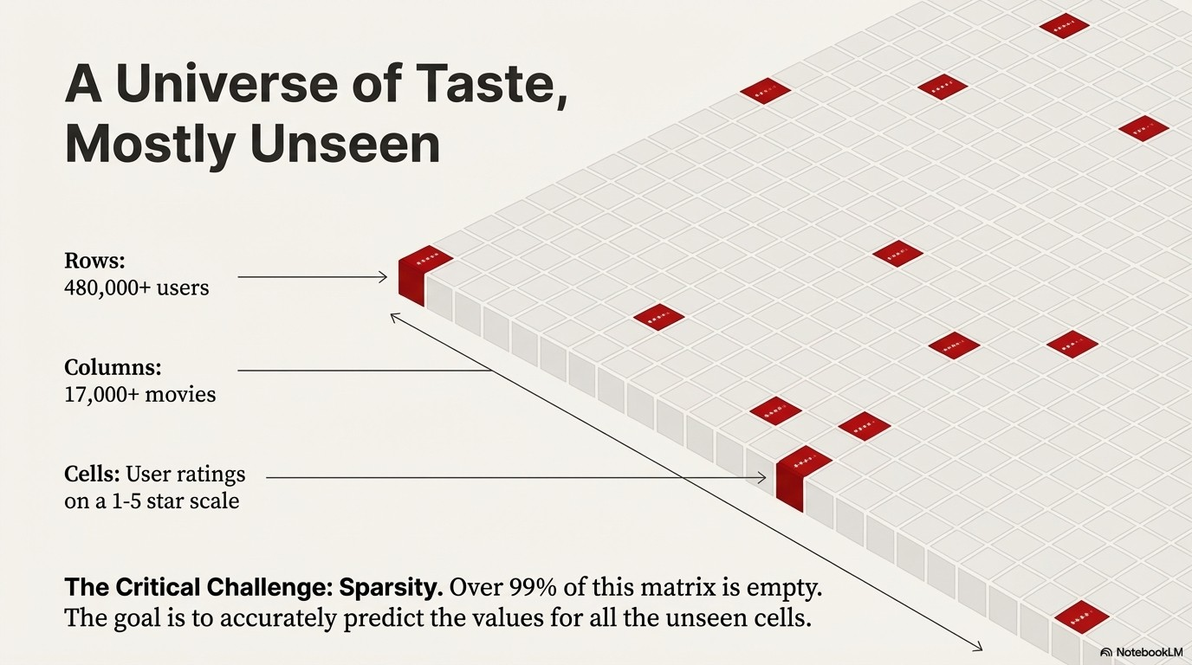

Slide 5
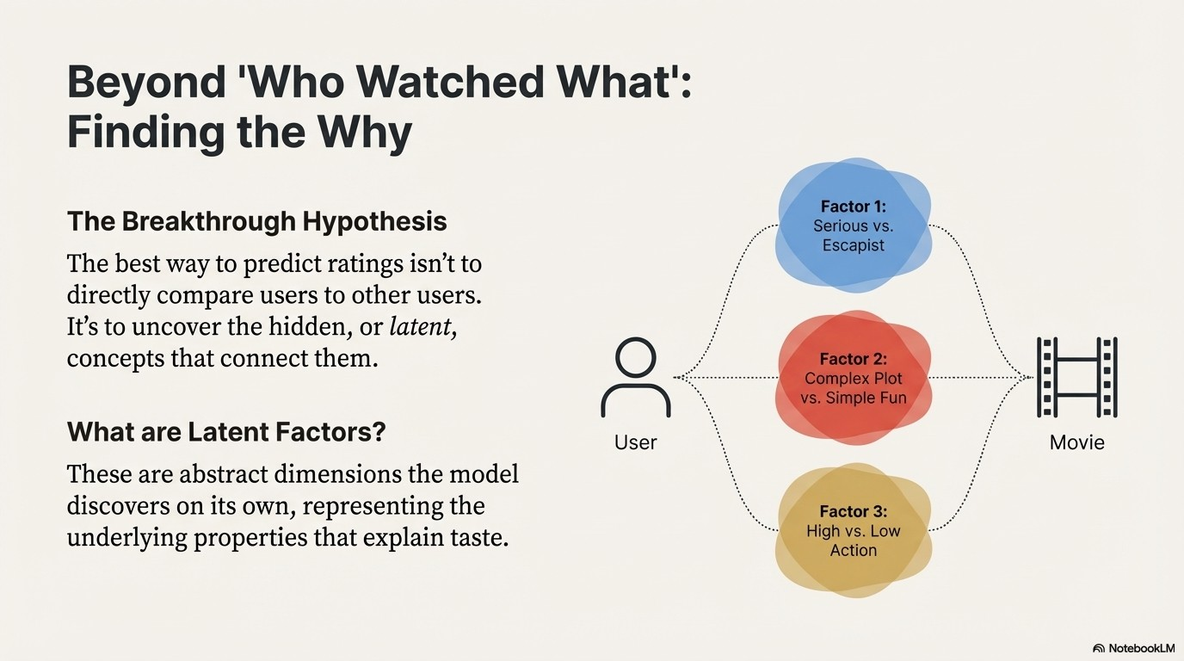

Slide 6
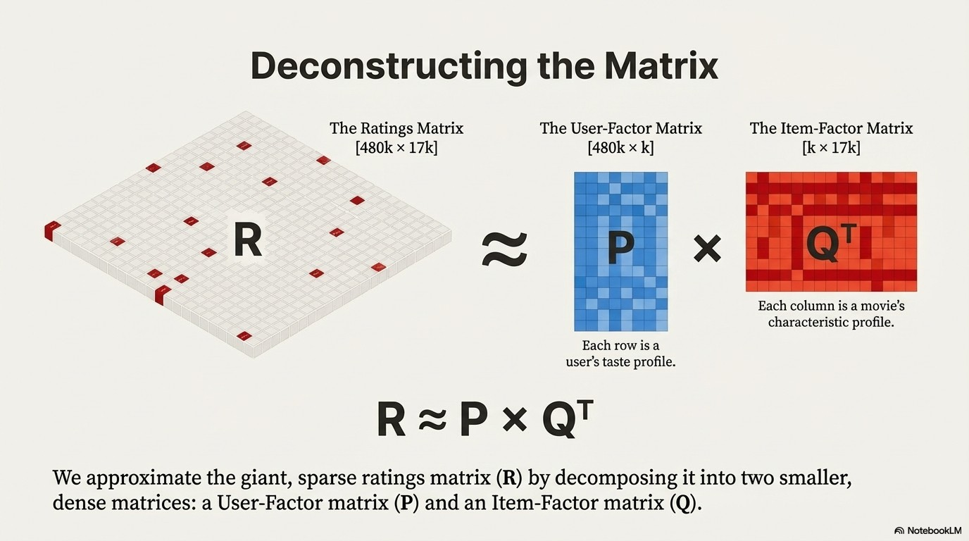

Slide 7
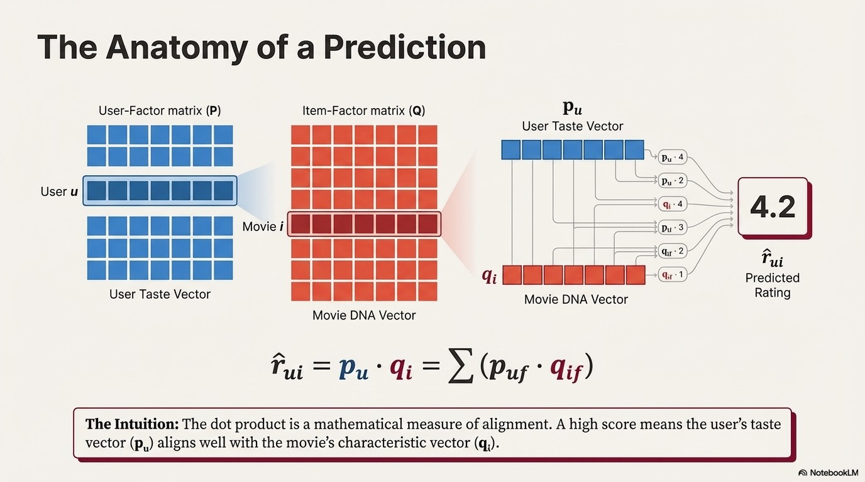

Slide 8
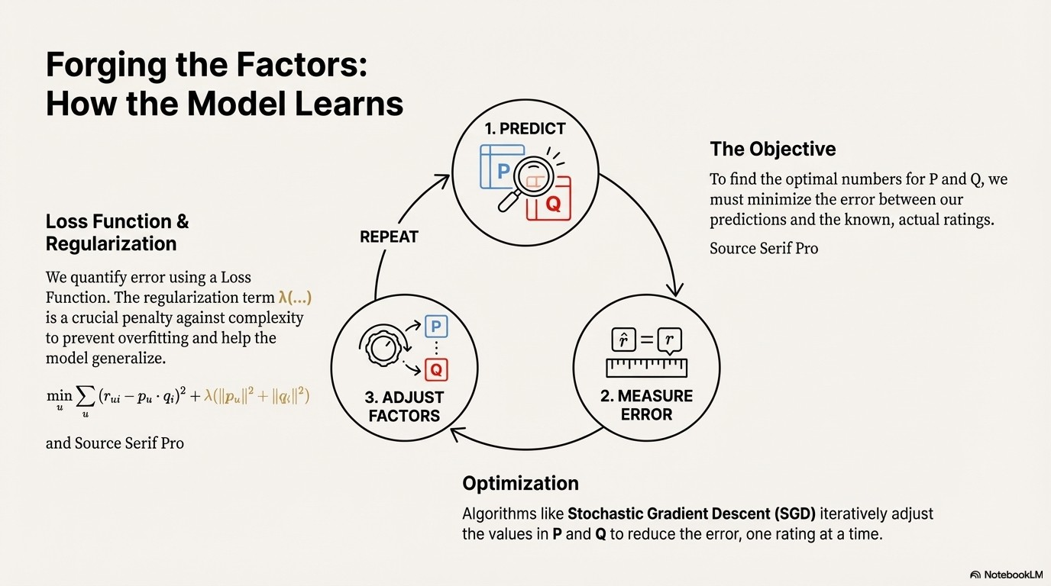

Slide 9
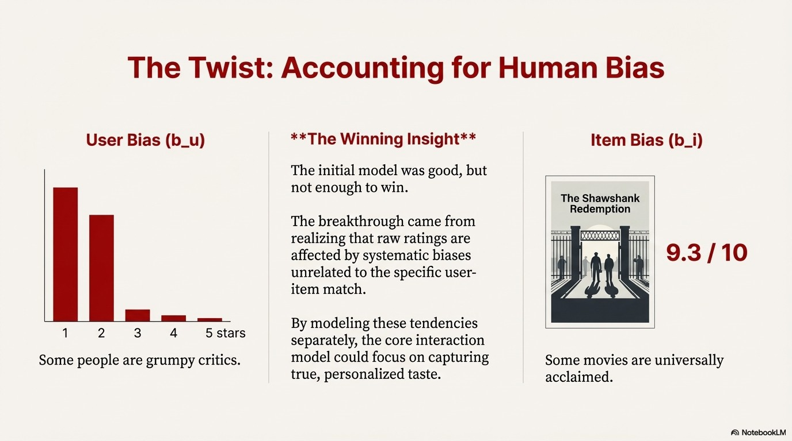

Slide 10
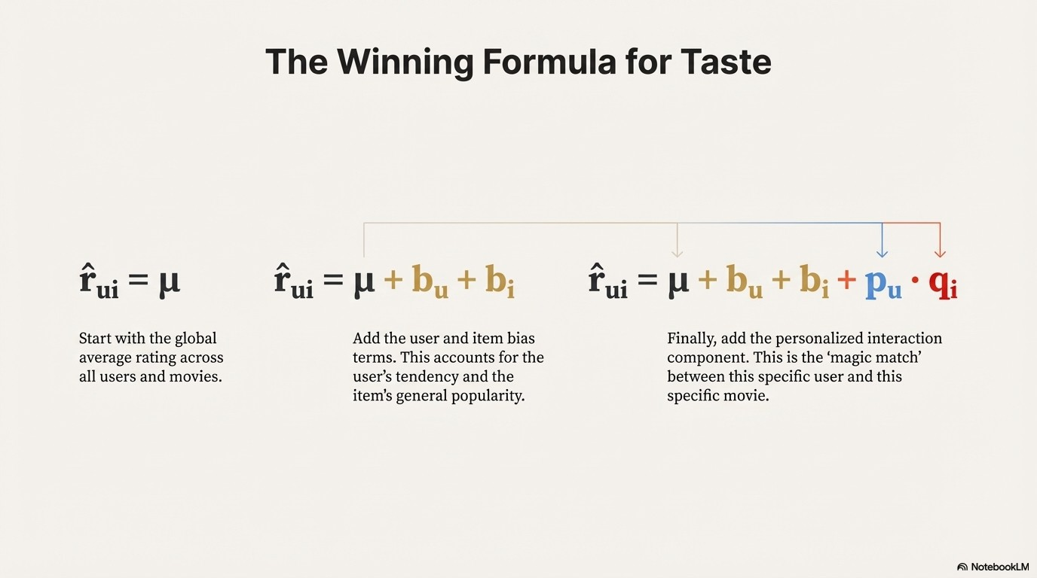

Slide 11
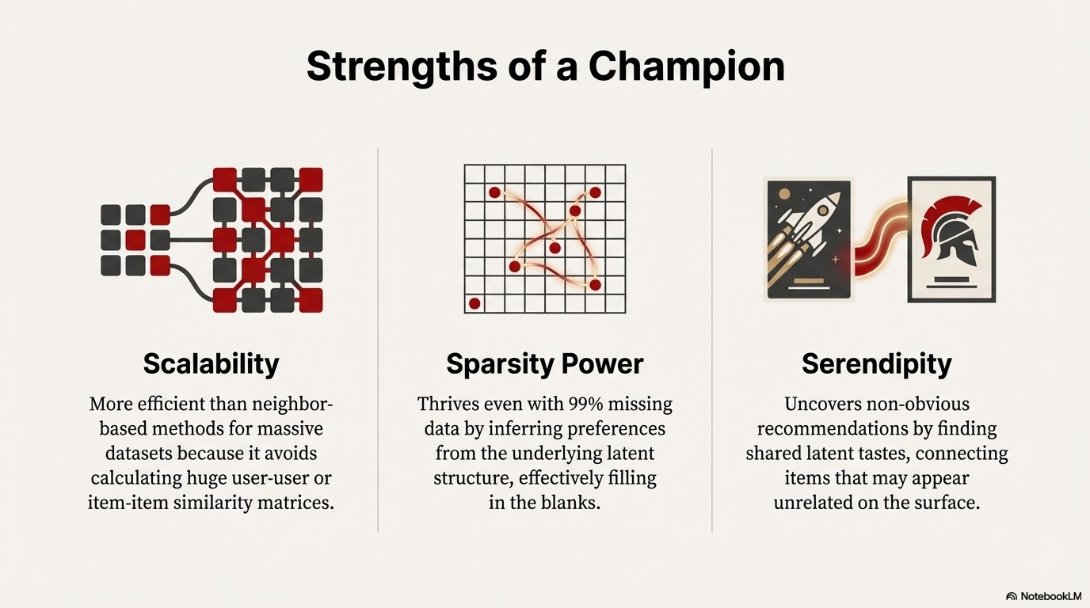

Slide 12
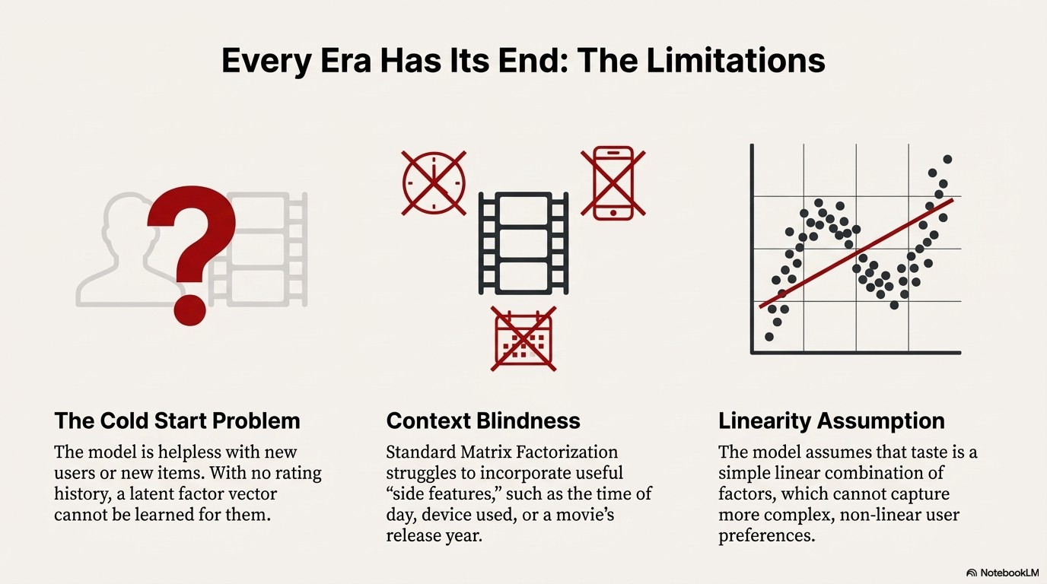

Slide 13
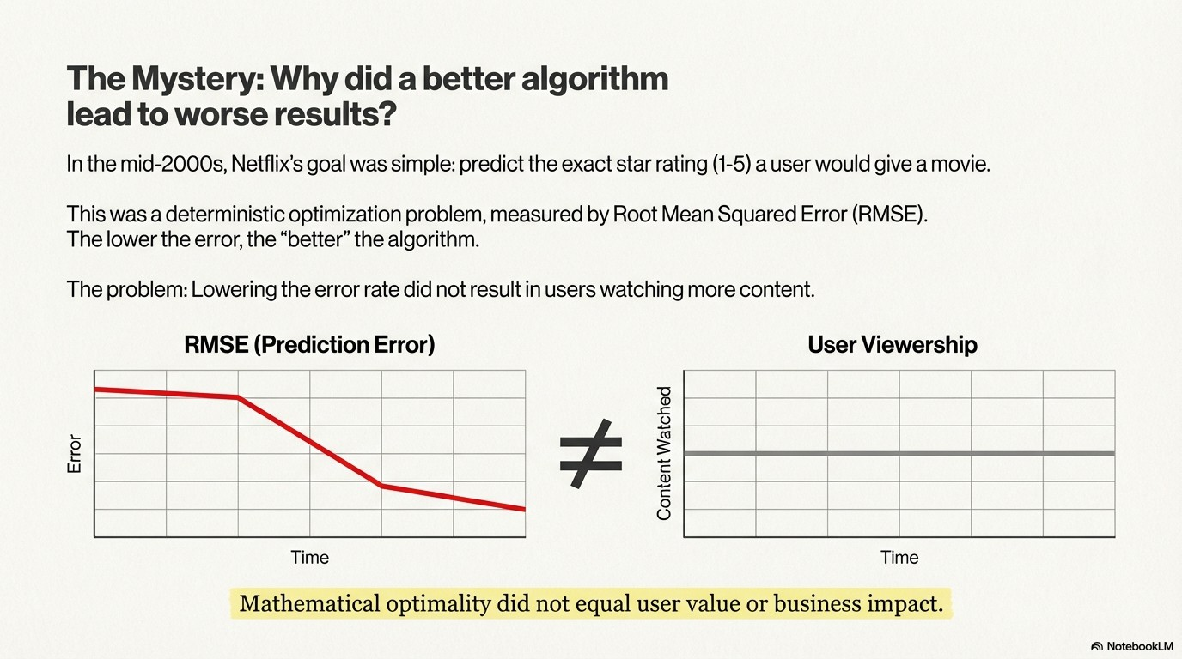

Slide 14
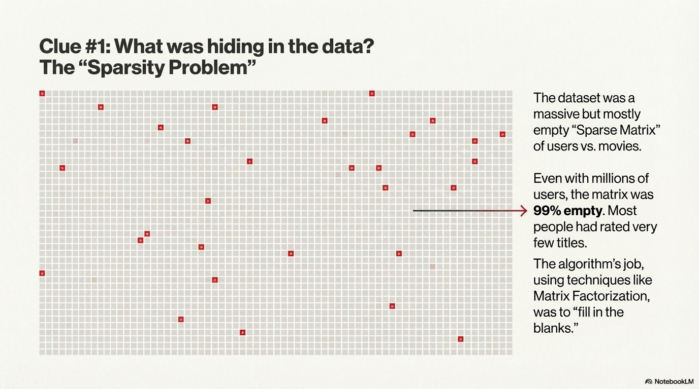

Slide 15
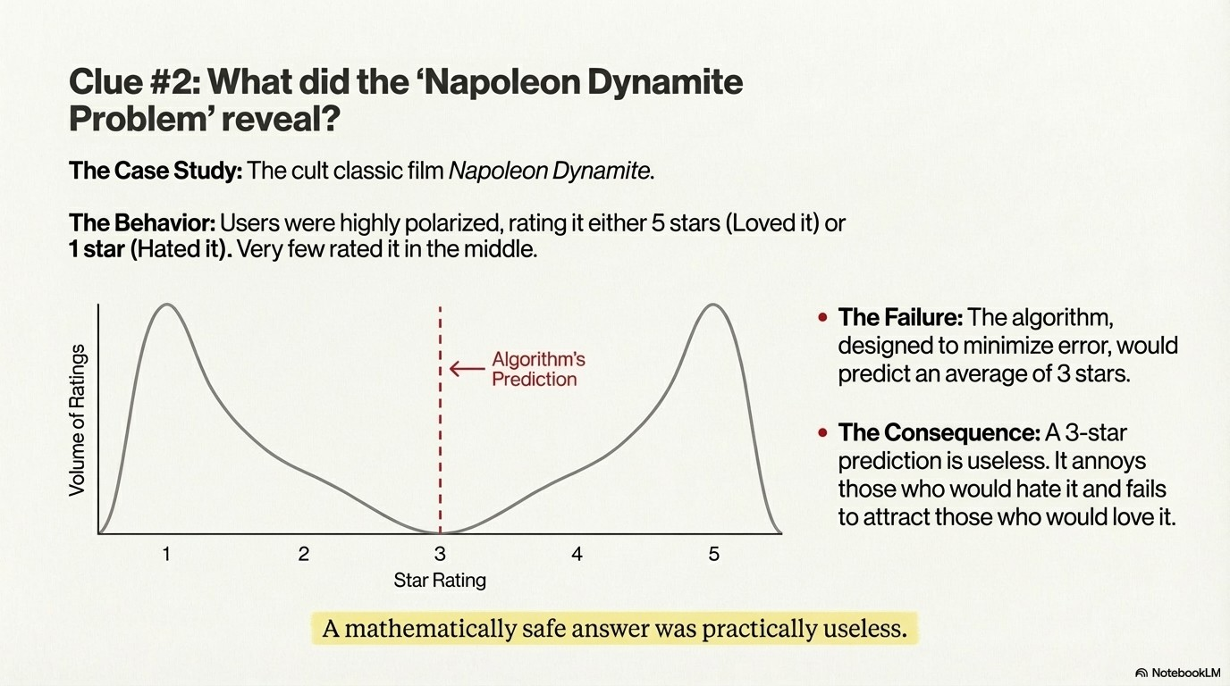

Slide 16
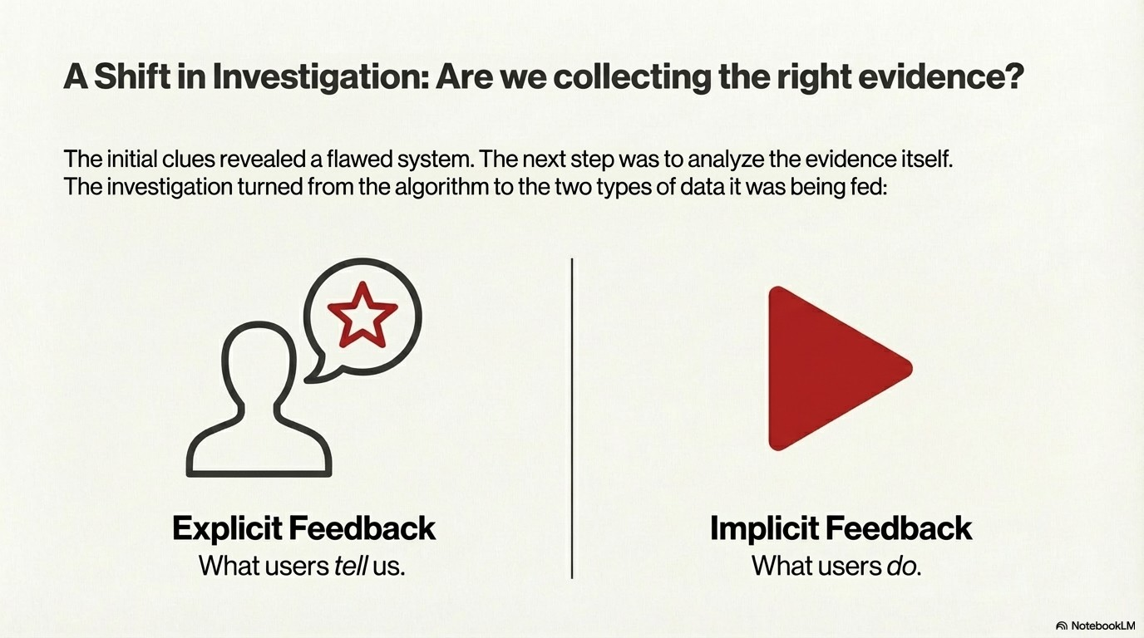

Slide 17
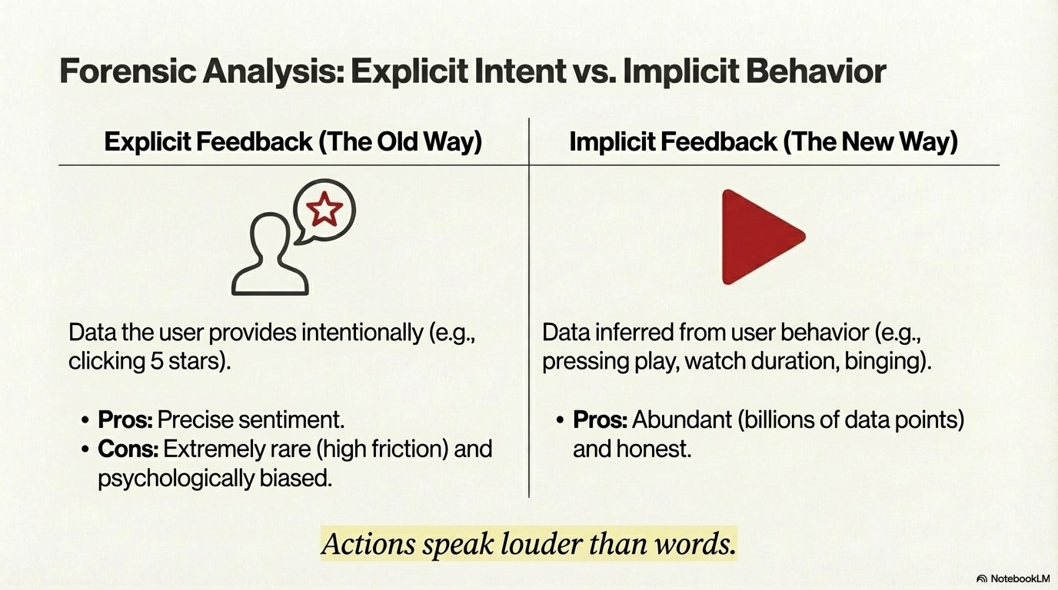

Slide 18
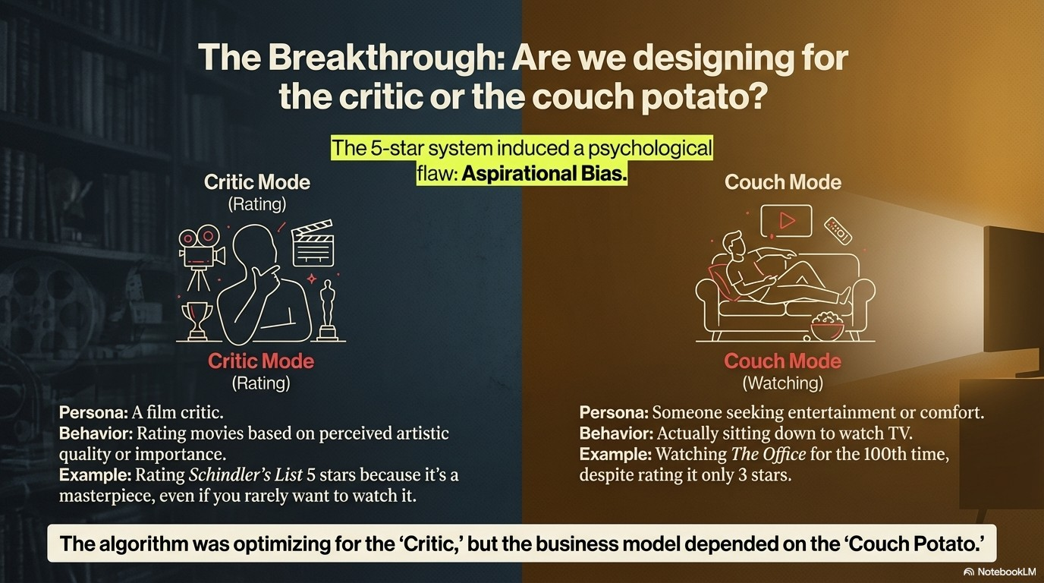

Slide 19
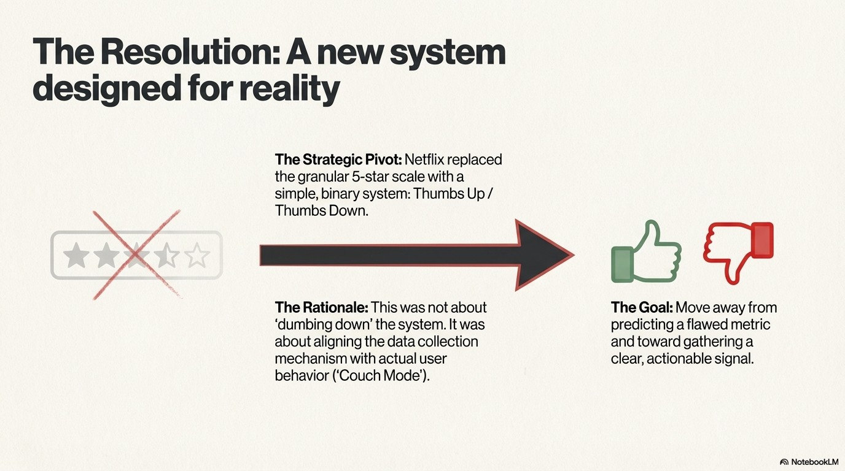

Slide 20
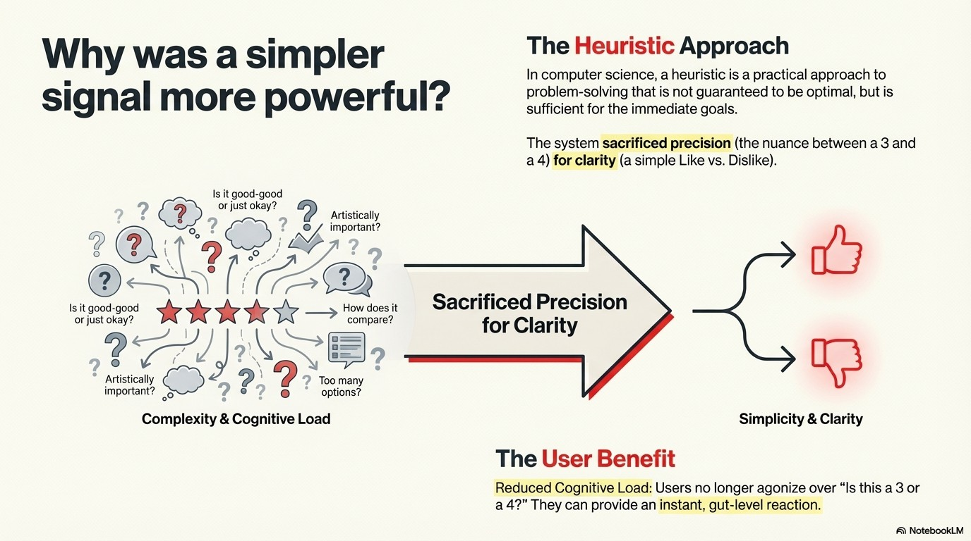

Slide 21
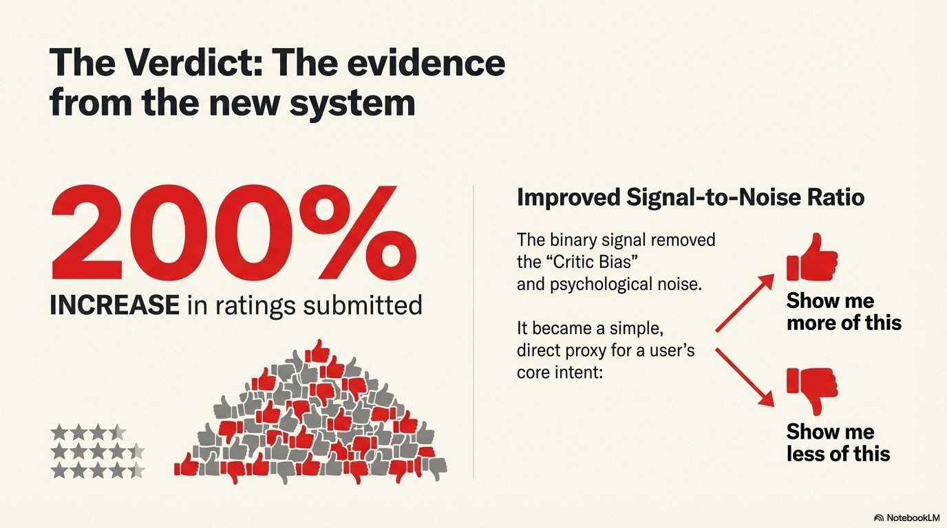

Slide 22
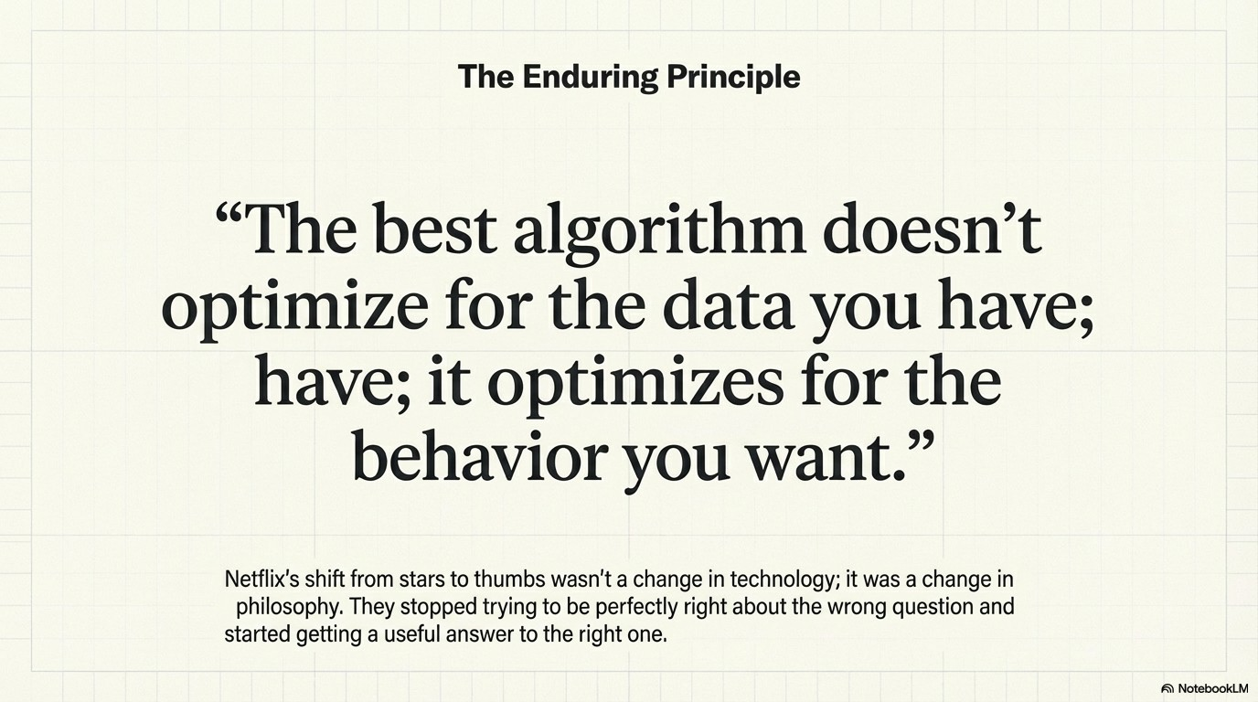

Slide 23
PART 3
MODERN NETFLIX ARCHITECTURE
From 5-Star Determinism to Probability-Driven Deep Learning

Slide 24
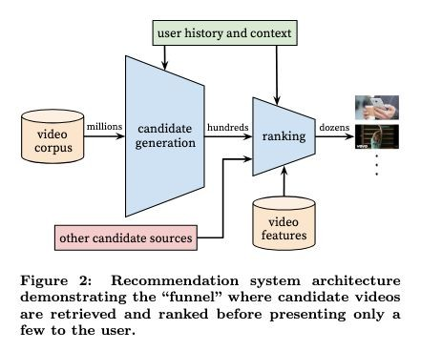
The Recommendation Funnel
From Millions to Dozens
The modern architecture is a multi-stage funnel designed to filter the massive catalog down to a single, personalized homepage.
Candidate Generation: Reduces billions of interactions and thousands of items to ~2,000 relevant candidates.
Ranking: Scores each candidate using
heavy-duty machine learning models (thousands of features).
Re-Ranking: Applies heuristics for diversity,

Slide 25
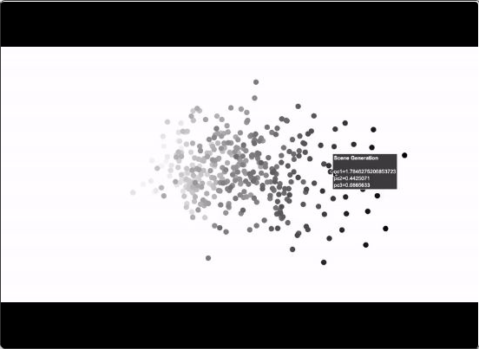
Candidate Generation: Embeddings
Beyond Matrix Factorization
While Matrix Factorization started the journey, modern candidate generation relies on sophisticated Embeddings and Approximate Nearest Neighbor (ANN) search.
Vector Space: Users and Titles are mapped to a
high-dimensional vector space where "closeness" equals "preference."
Foundation Models: Transformer-based architectures now predict the "next likely title" in a sequence of user actions.
Retrieval: Systems retrieve ~2,000 highly probable items in milliseconds for the ranking stage.

Slide 26
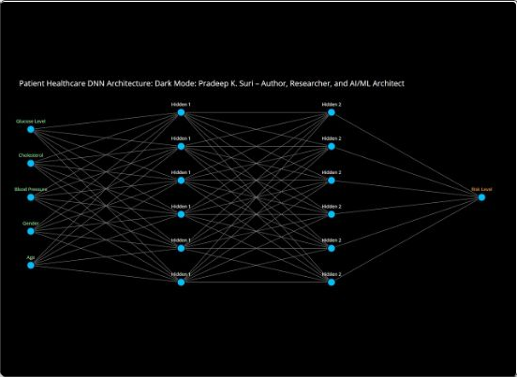
Ranking: Probability-Driven Models
Binary Classification at Scale
We no longer predict a 1-5 star rating. We predict the
probability of specific binary actions.
Predictive Goals: $P(\text{play})$, $P(\text{finish})$,
$P(\text{thumbs\_up})$.
The Model Stack: A hybrid of Gradient Boosted Decision Trees (GBDT) for structured data and Deep Neural Networks (DNN) for complex feature interactions. Input Signals: Explicit feedback (Thumbs), Implicit signals (Watch time, search history), and Context (Time of day, Device).

Slide 27
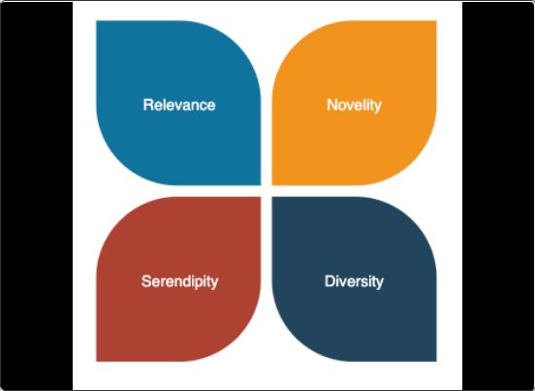

Re-Ranking: The Heuristic Layer
Solving for "Homogeneity"
Pure probability ranking often fails by showing 10 identical items (e.g., 10 action movies). The re-ranking layer ensures a balanced experience.
Diversity: Using Maximal Marginal Relevance (MMR) or
Determinantal Point Processes (DPP) to penalize items too similar to those already selected.
Freshness: Boosting new content to solve the "Cold Start" problem.
Filters: Removing watched items or maturity-restricted content.

Slide 28

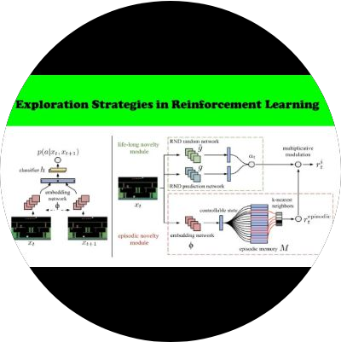
Exploration vs. Exploitation
The Bandit Approach
How does the system learn what you like if it only shows what you already like?
Exploitation: Showing content we know you will enjoy (High Probability). Maximizes immediate engagement.
Exploration: Showing new or uncertain content to gather data. Maximizes long-term learning.
Feedback Loop: The "Thumbs Up/Down" provides the critical binary signal that reinforces these Bandit algorithms, allowing the system to adapt rapidly to taste changes.

Slide 29
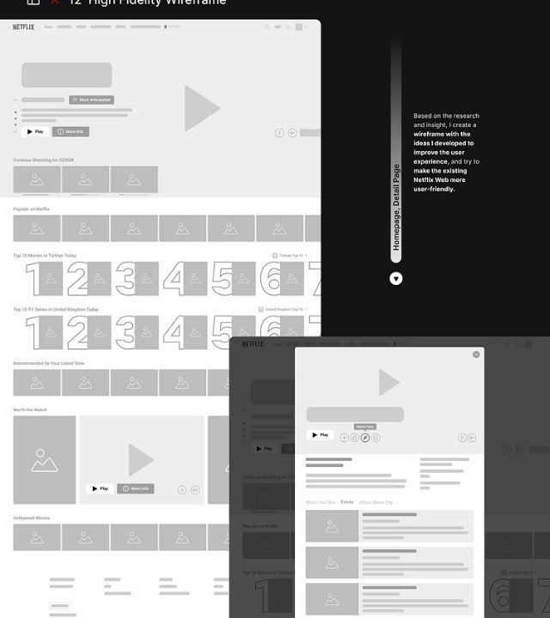
Page Composition
Row-Level Ranking
The final step isn't just ranking items, but ranking
Rows.
"Continue Watching": A deterministic row logic based on completion rates and recency. It often anchors the page.
Context Awareness: The page layout shifts based on device. A TV interface prioritizes different rows than a mobile interface.
Personalized Rows: Even the labels of the rows (e.g., "Because you watched X") are dynamically generated to explain the recommendation to the user.

Slide 30






Architecture Summary
1.
Retrieve
Generate ~2,000 candidates
from catalog using Embeddings & ANN.
2. Rank
3.
Filter
Apply heuristics for diversity,
freshness, and business rules.
4.
Construct
Assemble the final rows and
page layout for the user.
Score candidates using
GBDT & DNNs for
$P(\text{play})$ &
$P(\text{like})$.

Slide 31
Thank You

